Slide 1
TABLE OF CONTENTS:
I. INTRODUCTION
A. Pricing
FTS
DETAILS
A. Detail Processing Logic
B. Selection Screen
C. Data Mapping Requirements
D. Dependencies
E. Constraints
F. Test Specification
4. Final Price

Slide 2
Pricing FTS
Pricing
A Price book contains prices for products in SAP CPQ
Multiple prices for one product (discounts, special offerings, loyalty discounts, etc.)
Multiple Price books are grouped under a Market.

Slide 3
Pricing FTS
Product
Discounts
Special offerings
Loyalty discounts

Slide 4
Pricing FTS
Why we don’t use price books?
Part number, extra details.
Why we are using Custom tables instead of Price books?

Slide 5
FTS
Where the opportunities will be created in C4C and based on the opportunity stages, the sales reps configure the products in the CPQ system with the services being offered.
CPQ calculates the pricing based on the configuration.
send it to the customer for acceptance along with the terms and conditions
Once the quote is internally approved and accepted by the customer, it is replicated to CRM to create contract.
What is FTS / Use of this product?
Factory Transition Service (Z0007)
Example:
FTS Product code – Z0007

Slide 6
De- Installation
Installation
Origin
a
b
c
d
e
Destination

Slide 7
FTS price calculation Logic:
System first check the Historical price (pricebook) and if available then apply this price which will be sources from ECC.
If system does not find the price book then below logic will apply
Labor price: (FTS labor price* hours)*1.05 (Note: Labor prices will be sourced from within CPQ)
Foreseen Material price: customer spare net (sourced from ECC pricebook in CPQ)
Shipping kit use fee: System will apply Shipping kit use fee as fixed value from CPQ price book table. Table will be created in CPQ which will contain the Shipping KIT fixed fee by tool type.
3rd Party support margin % by black-book

Slide 8
Custom table to store the ref. hours for ROW:
Below table need to be created in CPQ to store the reference hours and need to be read during configuration and populate the number of hours from this table on the configuration.
Pass the tool type and tool config. in this table to retrieve the reference hours from below table and populate on the configurator.
1. De-commission CE Hours
2. De-commission tech. hours
3. Installation CE Hours
Installation Tech. hours.
Table name in CPQ : TBL_FTS_ROW_HRS

Slide 9
CPQ Price books – Custom price book for ROW:
1) Price book for AMNA – Create below custom table. For the ROW (rest of the world) we need to go into below price book and apply the decommission or installation price on the quote.
Logic: This table will be read only in below conditions.
If the customer is other than TSMC (will come from C4C)
If the Region is AMNA (Will come from C4C customer)
Pass the Tool type to the relevant installation/de-installation price
If number of hours changes and the difference between reference hours and the changed hours is <20% then always go to the price book
Table name in CPQ : TBL_FTS_PRICEBOOK

Slide 10
2) Pricebook for AME – Create below custom table. For the ROW (rest of the world) we need to go into below pricebook and apply the decommission or installation price on the quote.
Logic: This table will be read only in below conditions.
If the customer is other than TSMC (will come from C4C)
If the Region is AME (Will come from C4C customer)
Pass the Tool type to the relevant installation/de-installation price
If number of hours changes and the difference between reference hours and the changed hours is <20% then always go to the price book
Table name in CPQ : TBL_FTS_PRICEBOOK

Slide 11
3) Pricebook for AMSEA – Create below custom table. For the ROW (rest of the world) we need to go into below pricebook and apply the decommission or installation price on the quote.
Logic: This table will be read only in below conditions.
If the customer is other than TSMC (will come from C4C)
If the Region is AMSEA (Will come from C4C customer)
Pass the Tool type to the relevant installation/de-installation price
If number of hours changes and the difference between reference hours and the changed hours is <20% then always go to the price book
Table name in CPQ : TBL_FTS_PRICEBOOK

Slide 12
4) Pricebook for AMC– Create below custom table. For the ROW (rest of the world) we need to go into below pricebook and apply the decommission or installation price on the quote.
Logic: This table will be read only in below conditions.
If the customer is other than TSMC (will come from C4C)
If the Region is AMC (Will come from C4C customer)
Pass the Tool type to the relevant installation/de-installation price
If number of hours changes and the difference between reference hours and the changed hours is <20% then always go to the price book
Table name in CPQ : TBL_FTS_PRICEBOOK

Slide 13
5) Pricebook for AMT– Create below custom table. For the ROW (rest of the world) we need to go into below pricebook and apply the decommission or installation price on the quote.
Logic: This table will be read only in below conditions.
If the customer is other than TSMC (will come from C4C)
If the Region is AMT (Will come from C4C customer)
Pass the Tool type to the relevant installation/de-installation price
If number of hours changes and the difference between reference hours and the changed hours is <20% then always go to the price book
Table name in CPQ : TBL_FTS_PRICEBOOK

Slide 14
6) Pricebook for AMJ– Create below custom table. For the ROW (rest of the world) we need to go into below pricebook and apply the decommission or installation price on the quote.
Logic: This table will be read only in below conditions.
If the customer is other than TSMC (will come from C4C)
If the Region is AMJ (Will come from C4C customer)
Pass the Tool type to the relevant installation/de-installation price
If number of hours changes and the difference between reference hours and the changed hours is <20% then always go to the price book
Table name in CPQ : TBL_FTS_PRICEBOOK

Slide 15
7) Pricebook for AMK– Create below custom table. For the ROW (rest of the world) we need to go into below pricebook and apply the decommission or installation price on the quote.
Logic: This table will be read only in below conditions.
If the customer is other than TSMC (will come from C4C)
If the Region is AMK (Will come from C4C customer)
Pass the Tool type to the relevant installation/de-installation price
If number of hours changes and the difference between reference hours and the changed hours is <20% then always go to the price book
Table name in CPQ : TBL_FTS_PRICEBOOK

Slide 16
For ROW Customer, we will always read above price book except:-
If the reference hours are changed by the sales rep and if the difference between reference hours and changed hours are >20% then we need to apply the below logic.
Pick the reference hours changed on the configuration/quote
De-Installation Hours
CE Hours
Tech. Hours
Installation Hours
CE Hours
Tech. Hours
Read the FTS Labor price table by passing the region e.g. AMNA and take the CE price and Tech Price.
Multiply the CE price *CE Hours ( $100*50 = $5000) is the DE installation price
Multiply the Tech price *tech Hours ( $100*50 = $5000) is the installation price
Below hours will be populated for ROW Hours table and user will be able to change them manually. If changed then apply the above logic.

Slide 17
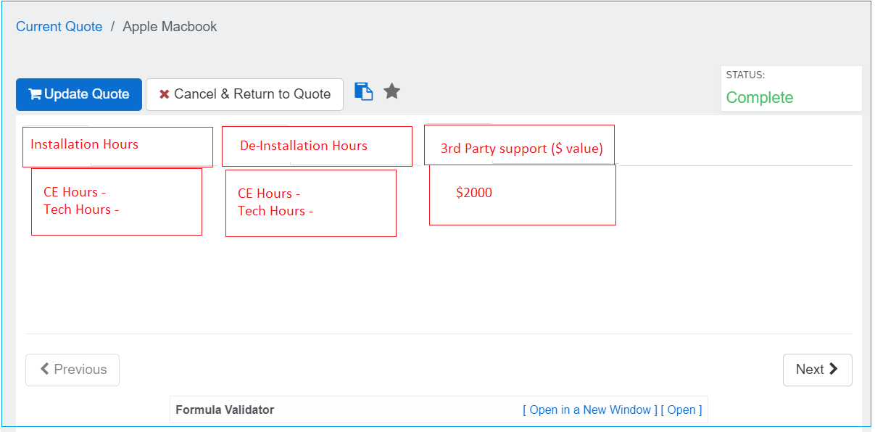

Slide 18
FTS Labor price by Region
Create below custom table to store the CE Labor price. CPQ quote will have customer region from C4C. Pass the region + Attribute selection e.g. Labor with attribute value “CE Labor” or “Tech Labor” system should read the below table to calculate the Labor Price.
Note: This table will only be read if reference hours are changed by the sales rep and the difference/variation from reference hours and changed hours are >20%
To calculate the labor price apply the below formula
Labor price = (FTS labor price* hours)*1.05
Table name in CPQ : Tbl_FTS_LaborPrice

Slide 19
Custom table to store the ref. hours for TSMC Customer.
Below table need to be created in CPQ to store the reference hours and need to be read during configuration and populate the number of hours from this table on the configuration.
Pass the tool type and tool config. and Node info in this table to retrieve the reference hours from below table.
De-commission CE Hours
3rd party support price
Installation CE Hours
3rd party support price.
Table Name in CPQ : Tbl_FTS_TSMC_Ref_Hours

Slide 20
CPQ Pricebooks – Custom price book for TSMC
Create below custom table. For the TSMC (Taiwan Semiconductor Mfg ) we need to go into below pricebook and apply the decommission or installation price on the quote.
Logic: This table will be read only in below conditions.
If the customer is TSMC (will come from C4C)
Pass the Tool type , Tool Config, Node information to get the relevant installation/de-installation price
If number of hours changes and the difference between reference hours and the changed hours is <20% then always go to the price book
Table Name In CPQ : Tbl_FTS_TSMC_Pricebook

Slide 21
For TSMC Customer, we will always read above price book except:-
If the reference hours are changed by the sales rep and if the difference between reference hours and changed hours are >20% then we need to apply the below logic.
Pick the reference hours changed on the configuration/quote
Installation CE Hours
De-Installation CE Hours
Read the FTS Labor price table by passing the region e.g. AMNA and take the CE price
Multiply the CE price *CE Hours ( $100*50 = $5000) is the DE installation price
Multiply the CE Price *CE Hours ( $100*50 = $5000) is the installation (T0/T1) price

Slide 22
Foreseen Material price in CPQ (From ECC )
If materials price is not available, trigger error and ask for removal to continue “Material price does not exists. Please remove the material from the quote.
To calculate the material price apply the below formula:
Material price = Spare customer net price * Qty
Note: If no price is available then show the error message “Price does not exist. Please remove the material from the quote”

Slide 23
3rd Party support margin % by black-book
Below custom table will be created in CPQ system and will be read if user select the 3rd part support as an attribute value to calculate the margin %.
For 3rd party support, FSO gets the quote ($ amount) from local vendor and sales team update the same to the system. Calculation (3rd party quote $ value/(1-margin)) will be applied to get 3rd party support price
Region “AMNA” etc. will be passed over from C4C to CPQ Quote. Region need to be read from CPQ quote and pass in the below table to calculate the 3rd party support price by applying margin.
3rd party support price = (3rd party support $ amount /1-margin %)
Table Name in CPQ : Tbl_FTS_SupportMargin

Slide 24
Shipping KIT Usage fee
Below custom table in CPQ to store the tool type / platform and the fixed use fee for the kit. Will be read from below table by passing the tool type and platform and add to the total value of the quote.
Shipping kit will be yes/no question; if yes (needed), one time fixed use fee will be added. Shipping kit fixed use fee table (see table 6) needs to be configured in CPQ.
Pass the tool type / Platform type to retrieve the usage fee.

Slide 25
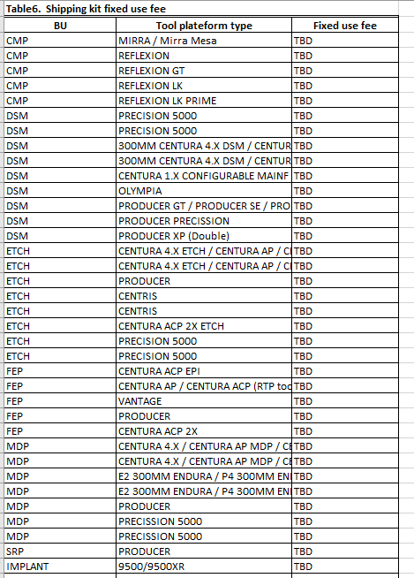

Slide 26
Final Price
Sum up the below to achieve the final price.
If the Reference hour changed then:
Final price = (FTS labor price* hours)*1.05 + 3rd party support price ($value /1-margin) + spare customer net price *qty + shipping kit fixed use fee
E.g. Final price = ($250*100)*1.05+ $100 *20 + $100 .
If the Reference hour are not changed then:
read from standard pricebook i.e.
Final price = De-installation price + Installation price (t0/t1) + T2 installation price (If any) + + spare customer net price *qty + shipping kit fixed use fee

Slide 27
The End
Thank you…

